Slide 1


Job Analytics
InstaHyre
Team Members
Shridhar Kamathe
Mohit Kumar
Rahul Bhadauria
Ajay Vishwakarma

Slide 2

Job Analytics
Of InstaHyre
Team Members
Shridhar Kamathe
Mohit Kumar
Rahul Bhadauria
Ajay Vishwakarma
InstaHyre
Scraping and Analysing data
from Website Instahyre
Create a Job Search Portal
Objective
Index

Slide 3
Shridhar Kamathe
Mohit Kumar
Rahul Bhadauria
Ajay Vishwakarma
Team Members
Objective
Scraping and Analysing data
from Website Instahyre
Create a Job Search Portal
InstaHyre
Python
Tools Used
Excel
HTML
Natural Language
Toolkit

Slide 4



Create a Job Search Portal
Objective
Scraping and Analysing data
from Website Instahyre
Python
Excel
Tools Used
HTML
Natural Language
Toolkit
NLTK
InstaHyre
5
Hosting
Steps
Building API and
Preparing HTML Code
Analysing and
Finding Insights
Data Cleaning and
Data Preprocessing
1
3
Web Scraping using
Selenium and BeautifulSoup
4
2

Slide 5


Tools Used
NLTK
Python
Excel
HTML
Natural Language
Toolkit
5
Hosting
Steps
4
Building API and
Preparing HTML Code
3
Analysing and
Finding Insights
2
Data Cleaning and
Data Preprocessing
1
Web Scraping using
Selenium
InstaHyre

Slide 6


Steps
Hosting
Building API and
Preparing HTML Code
Analysing and
Finding Insights
Data Cleaning and
Data Preprocessing
2
3
4
5
1
Web Scraping using Selenium
InstaHyre
Pandas
Excel

Slide 7

1
3
4
5
2
Data Cleaning and Data Preprocessing
Pandas
Excel
InstaHyre
Java is the most in demand skill followed by Python and JavaScript.
Mid Senior Level Positions has most number of openings and Director position has the least.
IT Services, Banking, Financial Services, Business Consultation are most popular industries as per applications.

Slide 8
Pandas
Excel
1
2
4
5
3
Analysing and Finding Insights
Java is the most in demand skill followed by Python and JavaScript.
Mid Senior Level Positions has most number of openings and Director position has the least.
IT Services, Banking, Financial Services, Business Consultation are most popular industries as per applications.
InstaHyre

Slide 9

IT Services, Banking, Financial Services, Business Consultation are most popular industries as per applications.
Mid Senior Level Positions has most number of openings and Director position has the least.
Java is the most in demand skill followed by Python and JavaScript.
1
2
4
5
3
Analysing and Finding Insights
Larger Firms are offering more jobs than that of smaller firms.
IT and SOFTWARE sectors are leading on LinkedIn in terms of followers, followed by Consumer Electronics and Finance sector.
InstaHyre
Using flask to build API
Using HTML to create a webpage to display
the search results summary

Slide 10


IT and SOFTWARE sectors are leading on LinkedIn in terms of followers, followed by Consumer Electronics and Finance sector.
Larger Firms are offering more jobs than that of smaller firms.
1
2
3
5
4
Building API and Preparing HTML Code
Using flask to build API
Using HTML to create a webpage to display
the search results summary
InstaHyre
Skill Search Home Page

Slide 11
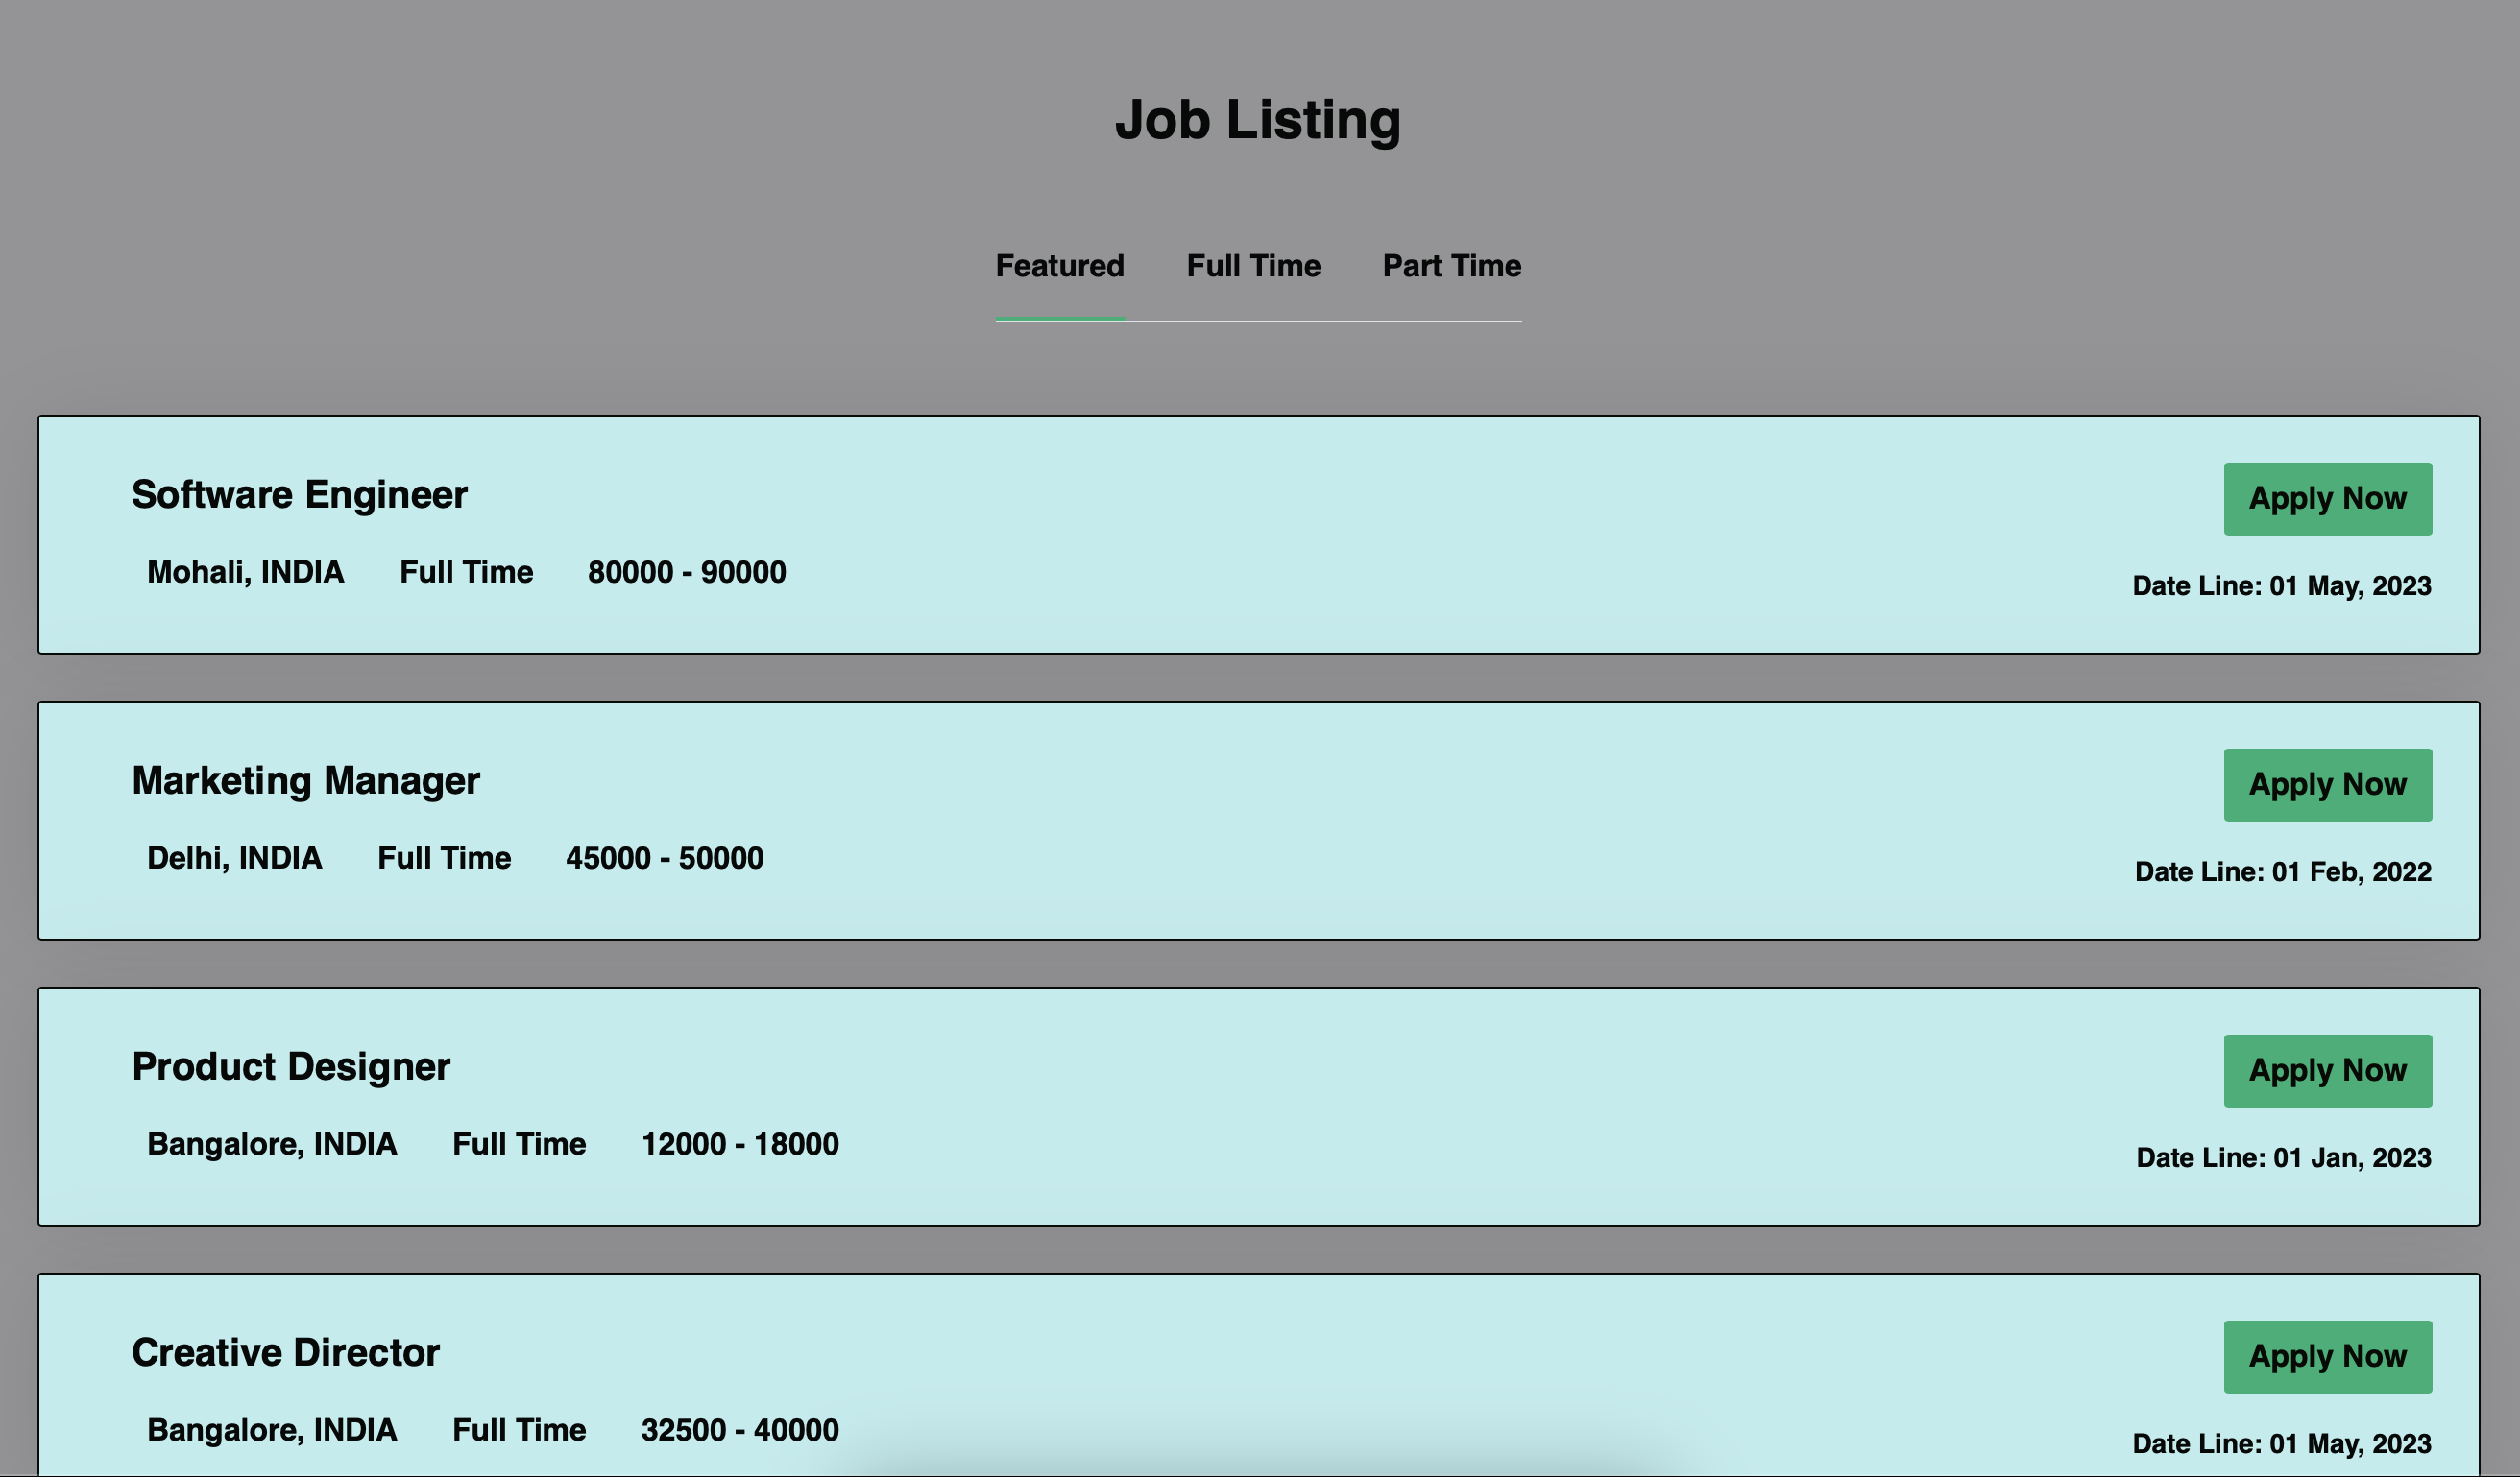
Using HTML to create a webpage to display
the search results summary
Using flask to build API
1
2
3
4
5
Hosting
Skill Search Home Page
InstaHyre

Slide 12


Skill Search Home Page
1
2
3
4
5
Hosting
InstaHyre
Scraping Data from LinkedIn was
particularly challenging because every
profile have different xpath
Using NLTK library to make the search option
available for misspelt words.
Challenges Faced

Slide 13

5
Hosting
1
2
3
4
Challenges Faced
Scraping Data from LinkedIn was
particularly challenging because every
profile have different xpath
Using NLTK library to make the search option
available for misspelt words.
InstaHyre

Slide 14
Using NLTK library to make the search option
available for misspelt words.
Challenges Faced
Scraping Data from LinkedIn was
particularly challenging because every
profile have different xpath
InstaHyre

